Slide 1
PROJECT SCHEDULING AND
TRACKING

Slide 2
PROJECT SCHEDULING AND TRACKING
Software project scheduling is an activity that distributes estimated effort across the planned project duration by allocating the effort to specific software engineering tasks.
During early stages of project planning, a macroscopic schedule is developed.
This type of schedule identifies all major software engineering activities and the product functions to which they are applied.
As the project gets under way, each entry on the macroscopic schedule is refined into a detailed schedule.

Slide 3
Basic Concept
Why software is delivered late?
An unrealistic deadline established
Changing customer requirements that are not reflected in schedule changes.
underestimate of the amount of effort and/or the number of resources that will be required to do the job.
Predictable and/or unpredictable risks that were not considered when the project commenced.
Technical difficulties that could not have been foreseen in advance.
Human difficulties that could not have been foreseen in advance.
Miscommunication among project staff that results in delays.
A failure by project management to recognize that the project is falling behind schedule and a lack of action to correct the problem.

Slide 4
What should we do when management demands that make a deadline that is impossible?
Perform a detailed estimate using historical data from past projects. Determine the estimated effort and duration for the project.
Using an incremental process model that will deliver critical functionality by the imposed deadline. Document the plan.
Meet with the customer and (using the detailed estimate), explain why the imposed deadline is unrealistic.
Offer the incremental development strategy as an alternative

Slide 5
Basic principle
Compartmentalization: The project must be compartmentalized into a number of manageable activities and tasks.
To accomplish compartmentalization, both the product and the process are decomposed.
Interdependency. The interdependency of each compartmentalized activity or task must be determined.
Some tasks must occur in sequence while others can occur in parallel.
Some activities cannot commence until the work product produced by another is available.

Slide 6
Contd.
Time allocation. Each task to be scheduled must be allocated some number of work units (e.g., person-days of effort).
In addition, each task must be assigned a start date and a completion date that are a function of the interdependencies
Effort validation. As time allocation occurs, the project manager must ensure that no more than the allocated number of people have been scheduled at any given time.
Defined responsibilities. Every task that is scheduled should be assigned to a specific team member.
Defined outcomes. Every task that is scheduled should have a defined outcome. For software projects, the outcome is normally a work product or deliverable.
Defined milestones. A milestone is accomplished when one or more work products has been reviewed for quality and has been approved.

Slide 7
DEFINING A TASK SET
A task set is a collection of software engineering work tasks, milestone, and deliverables that must be accomplished to complete a particular project.
The task set must provide enough discipline to achieve high software quality. But, at the same time, it must not load the project team with unnecessary work.
To develop a project schedule, a task set must be distributed on the project timeline. Task set will vary depending upon the project type and the degree of rigor.
Task sets are designed to accommodate different types of projects and different degrees of rigor.

Slide 8
Contd.
To define a Task set
  Determine Project Type
  Identify adaptation criteria
  Assess the degree of rigor required
  Select appropriate software engineering tasks.

Slide 9
Determine the project type
  Concept development projects that are initiated to explore some new business concept or application of some new technology.
  New application development projects that are undertaken as a consequence of a specific customer request.
  Application enhancement projects that occur when existing software undergoes major modifications to function, performance, or interfaces that are observable by the end-user.
  Application maintenance projects that correct, adapt, or extend existing software in ways that may not be immediately obvious to the end-user.
  Reengineering projects that are undertaken with the intent of rebuilding an existing (legacy) system in whole or in part.

Slide 10
Identify adaptation criteria
Size of project
Number of potential users.
Mission criticality
Application longevity
Stability of requirements
Ease of customer/developer communication
Maturity of applicable technology
Performance constraints,
Project staff
Reengineering.

Slide 11
Each of the adaptation criteria is assigned a grade that ranges between 1 and 5, where 1 represents a project in which a small subset of process tasks are required and 5 represents a project in which a complete set of process tasks should be applied

Slide 12
Degree of rigor
Adaptation criteria are used to determine the recommended degree of rigor with which the software process should be applied on a project.
The degree of rigor is a function of many project characteristics. As an example, small, non-business-critical projects can generally be addressed with somewhat less rigor than large, complex business-critical applications.
Finally, apply software engineering task.

Slide 13
A task set example
In order to develop a project schedule, a task set must be distributed on the project time line.
Major software engineering tasks are applicable to all process model flows.
As an example, we consider the software engineering tasks for a concept development project.

Slide 14
Major Task Set for concept development project are:
Concept scoping determines the overall scope of the project.
Preliminary concept planning establishes the organization’s ability to undertake the work implied by the project scope.
Technology risk assessment evaluates the risk associated with the technology to be implemented as part of project scope.
Proof of concept demonstrates the feasibility of a new technology in the software context.
Concept implementation implements the concept representation in a manner that can be reviewed by a customer and is used for “marketing” purposes when a concept must be sold to other customers or management.
Customer reaction to the concept ask for feedback on a new technology concept and targets specific customer applications.

Slide 15
The software team must understand what must be done (scoping);
Then the team (or manager) must determine whether anyone is available to do it (planning),
Consider the risks associated with the work (risk assessment).
Prove the technology in some way (proof of concept)
Implement it in a prototypical manner so that the customer can evaluate it (concept implementation and customer evaluation).
Finally, if the concept is viable, a production version (translation) must be produced.

Slide 16
Refinement of Major Task
Refinement begins by taking each major task and decomposing it into a set of subtasks (with related work products and milestones)
As an example of task decomposition, consider concept scoping for a development Project
Task refinement can be accomplished using an outline format a process design language approach is used to illustrate the flow of the concept scoping activity

Slide 17
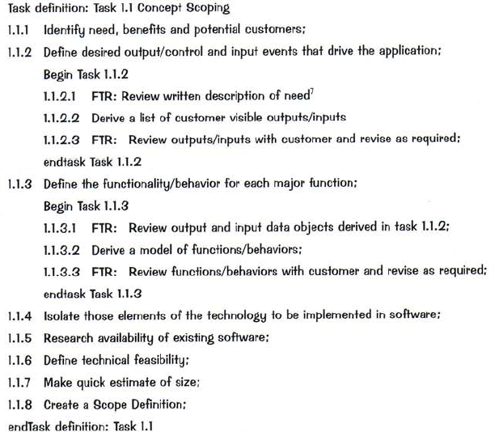

Slide 18
Defining a Task Network.
A task network, also called an activity network, is a graphic representation of the task flow for a project.
It is sometimes used as the mechanism through which task sequence and dependencies are input to an automated project scheduling tool.
Therefore, the task network depicts major software engineering tasks.
Fig. shows a schematic task network for a concept development project.
The concurrent nature of software engineering activities leads to a number of important scheduling requirements.

Slide 19
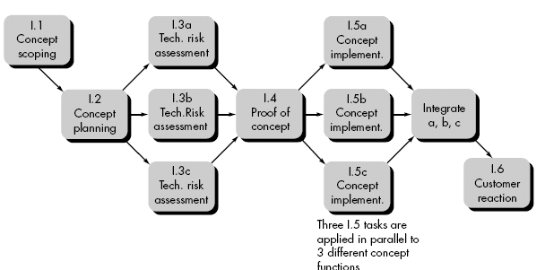

Slide 20
Because parallel tasks occur asynchronously, the planner must determine inter-task dependencies to ensure continuous progress toward completion.
The project manager should be aware of those tasks that lie on the critical path. That is, tasks that must be completed on schedule if the project as a whole is to be completed on schedule.
In a detailed task network each activity shown in fig.( refinement of Tasks 1.1) would be expanded.

Slide 21
SCHEDULING
Two project scheduling methods
  Program evaluation and review technique (PERT)
  critical path method (CPM)
Both techniques are driven by information already developed in earlier project planning activities:
  Estimates of effort
  A decomposition of the product function
  The selection of the appropriate process model and task set
  Decomposition of tasks
Interdependencies among tasks may be defined using a task network.
Tasks, sometimes called the project work breakdown structure (WBS), are defined for the product as a whole or for individual functions.

Slide 22
PERT and CPM provide quantitative tools that allow the software planner to
  Determine the critical path—the chain of tasks that determines the duration of the project
  Establish “most likely” time estimates for individual tasks by applying statistical models;
  Calculate “Boundary times” that define a time "window" for a particular task.
Both PERT and CPM have been implemented in a wide variety of automated tools that are available for the personal computer
E.g. Primevera software

Slide 23
Timeline Charts
The planner always begins with a set of tasks (the work breakdown structure).
If automated tools are used, the work breakdown is input as a task network or task outline.
Effort, duration, and start date are then input for each task. In addition, tasks may be assigned to specific individuals.
A timeline chart enables you to determine what tasks will be conducted at a given point in time.
A timeline chart can be developed for the entire project.
Alternatively, separate charts can be developed for each project function or for each individual working on the project.

Slide 24
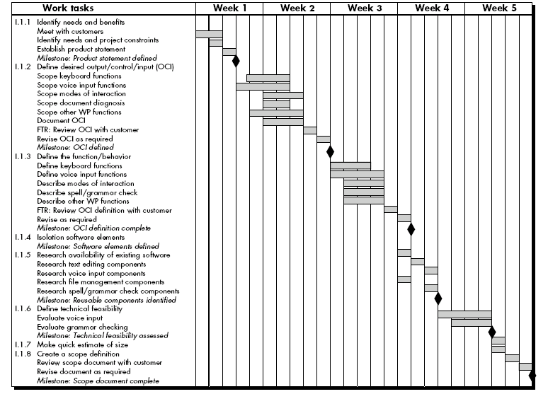

Slide 25
Contd.
All project tasks are listed in the left-hand column.
The horizontal bars indicate the duration of each task.
When multiple bars occur at the same time on the calendar, task concurrency is implied.
The diamonds indicate milestones.
Once the information necessary for the generation of a timeline chart has been input, the majority of software project scheduling tools produce project tables
It is a tabular listing of all project tasks, their planned and actual start- and end-dates, and a variety of related information.
Project tables enable the project manager to track progress.

Slide 26
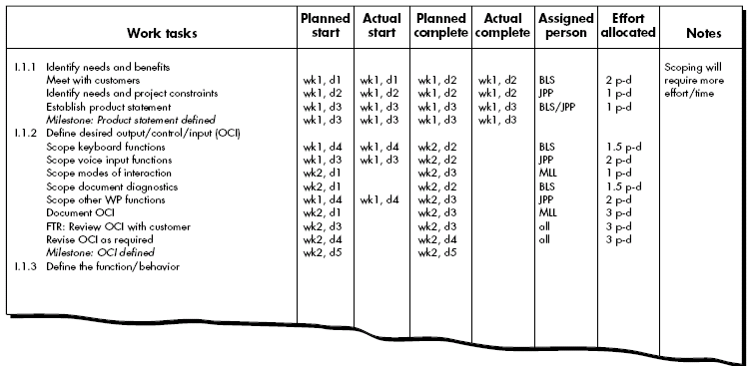
Project Table

Slide 27
Tracking the Schedule
Project schedule defines the tasks and milestones that must be tracked and controlled as the project proceeds.
Tracking can be accomplished in a number of different ways:
  Conducting periodic project status meetings in which each team member reports progress and problems.
  Evaluating the results of all reviews conducted
  Determining whether formal project milestones (i.e. diamonds) have been accomplished by the scheduled date.
  Comparing actual start-date to planned start-date for each project task listed in the resource table.
  Using earned value analysis to evaluate progress quantitatively.

Slide 28
EARNED VALUE ANALYSIS
The earned value system provides a common value scale for every task, regardless of the type of work being performed.
Simply stated, earned value is a measure of progress.
It enables us to assess the “percent of completeness” of a project using quantitative analysis
The total hours to do the whole project are estimated, and every task is given an earned value based on its estimated percentage of the total.

Slide 29
To determine the earned value
The budgeted cost of work scheduled (BCWS) is determined for each work task represented in the schedule.
  BCWSi is the effort planned for work task i.
  To determine progress at a given point along the project schedule, the value of BCWS is the sum of the BCWS_{i} values for all work tasks for that point in time.
The BCWS values for all work tasks are summed to derive the budget at completion, BAC.
Hence, BAC = ∑ (BCWS_{k}) for all tasks k

Slide 30
Next, the value for budgeted cost of work performed (BCWP) is computed.
The value for BCWP is the sum of the BCWS values for all work tasks that have actually been completed by a point in time on the project schedule.
  BCWS - budget of the activities that were planned to be completed
  BCWP - budget of the activities that actually were completed.”
Given values for BCWS, BAC, and BCWP, important progress indicators can be computed:
  Schedule performance index, SPI = BCWP/BCWS
  Schedule variance, SV = BCWP – BCWS
  SPI is an indication of the efficiency with which the project is utilizing scheduled resources.
SPI value close to 1.0 indicates efficient execution of the project schedule.

Slide 31
Percent scheduled for completion = BCWS/BAC
  Indication of the percentage of work that should have been completed by time t.
Percent complete = BCWP/BAC
  provides a quantitative indication of the percent of completeness of the project at a given point in time, t.
Actual cost of work performed, ACWP, is the sum of the effort actually expended on work tasks that have been completed by a point in time on the project schedule. It is then possible to compute
  Cost performance index, CPI = BCWP/ACWP
  Cost variance, CV = BCWP – ACWP
CPI value close to 1.0 provides a strong indication that the project is within its defined budget

Slide 32
Example :
Assume you are a software project manager and that you’ve been asked to computer earned value statistics for a small software project. The project has 56 planned work tasks that are estimated to require 582 person-days to complete. At the time that you’ve been asked to do the earned value analysis, 12 tasks have been completed. However, the project schedule indicates that 15 tasks should have been completed. The following scheduling data (in person-days) are available:

